Slide 1
Team 8
Implementation of a web-plugin for vision disabled people

Slide 2
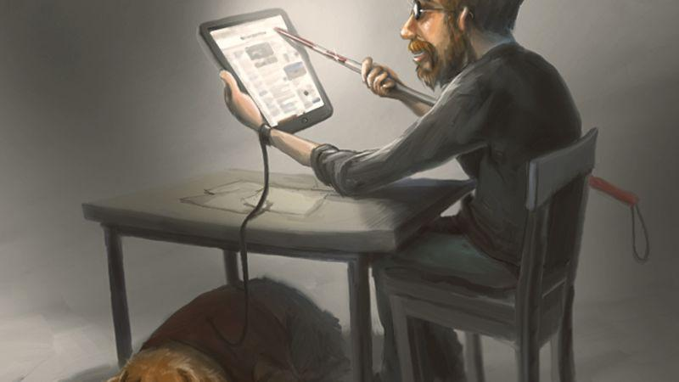
The problem
Internet has shifted more towards visual implementation and information
However not everyone can benefit from the modern customs
Some are actually put into more of a disadvantage

Slide 3

The solution
Plugin for Chrome
Web pages easier to navigate for the visually impaired.
Making the live chat accessible

Slide 4
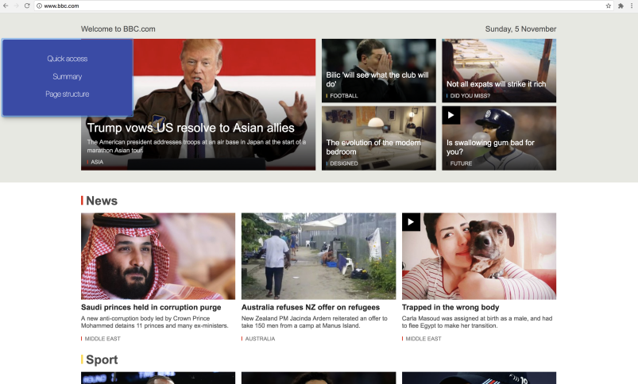
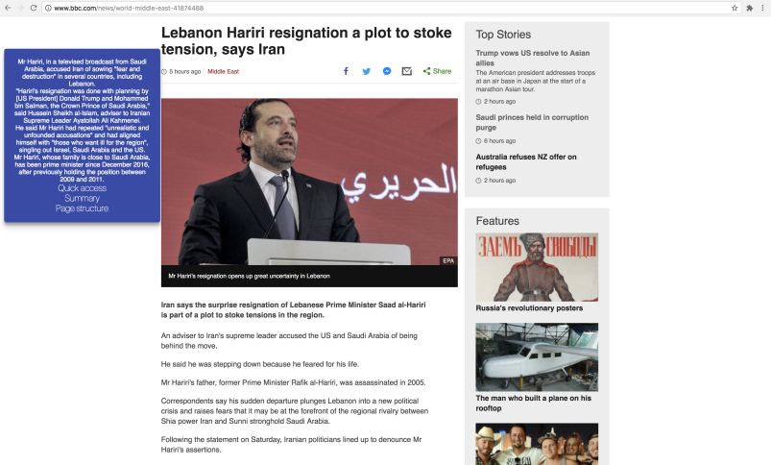
Easier web page navigation
Parsing the content of the web page and then through an API returns a summarized version
Describes an image on the page to the user
=>

Slide 5
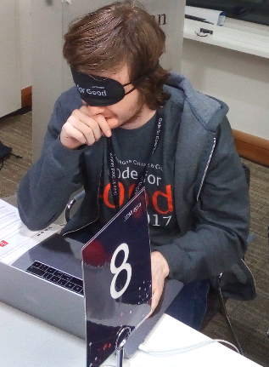
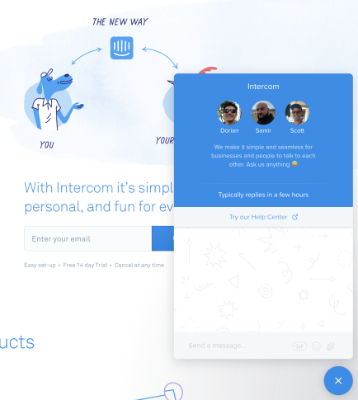

If you can’t see that doesn’t mean you can’t live chat
Intercom.com now available for our visually impaired friends
Reads the incoming messages to the user.

Slide 6
Time for a little demo of this bright creation

Slide 7
What lies ahead
Expanding to other browsers
Making a consistent solution across all live chats
A client based solution that is swift and make end user convenient

Slide 8
Thank you

